Slide 1
Capstone project E-Learning website
Unicorn Team

Slide 2

Project team
minhnt

Slide 3
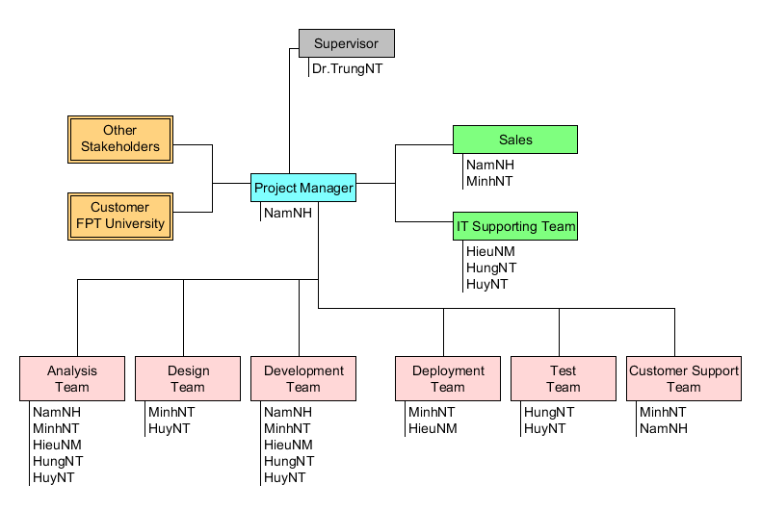
Project Management Plan Project Plan
Role and Responsible minhnt

Slide 4
Table content
1. Background
2. Ideal
3. Objective
4. Project Management Plan
5. Software Requirement Specification
6. System Analysis and Design
7. Test Plan and Test Report
8. Summary
9. Q&A

Slide 5
Background
minhnt

Slide 6
Idea
minhnt

Slide 7
objective
Minh nt

Slide 8
Project Management Plan
1. Software process model hieunm
2. Project plan
3. Risk management
4. Quality Plan

Slide 9
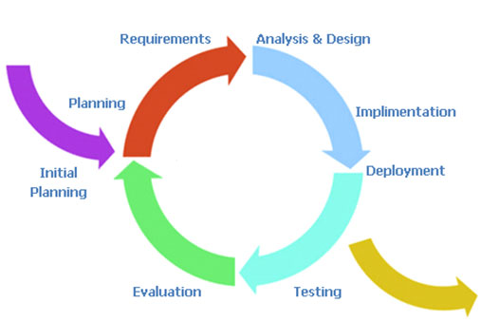
Project Management Plan Software process model
Iterative Model hieunm

Slide 10
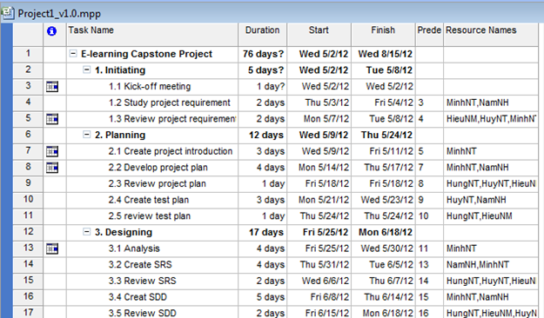
Project Management Plan Project Plan
Overall Plan hieunm

Slide 11
Project Management Plan Risk management
Hieu nm

Slide 12
Project Management Plan Quality plan
Hieu nm

Slide 13
Success criteria huy nt
The project that finishes in scheduled time, within the allocated budgets and which satisfies the customer requirements.
All high-priority functionality defined in the requirements specification is delivered in the first release.
Open-sources are optimized closely, less complexity, improving quality of the system.
The estimated number of residual defects does not exceed 5 per function point.

Slide 14
Software requirement specification
Functional requirement
Huy nt

Slide 15
Software requirement specification
Non-functional requirement
Huy nt

Slide 16
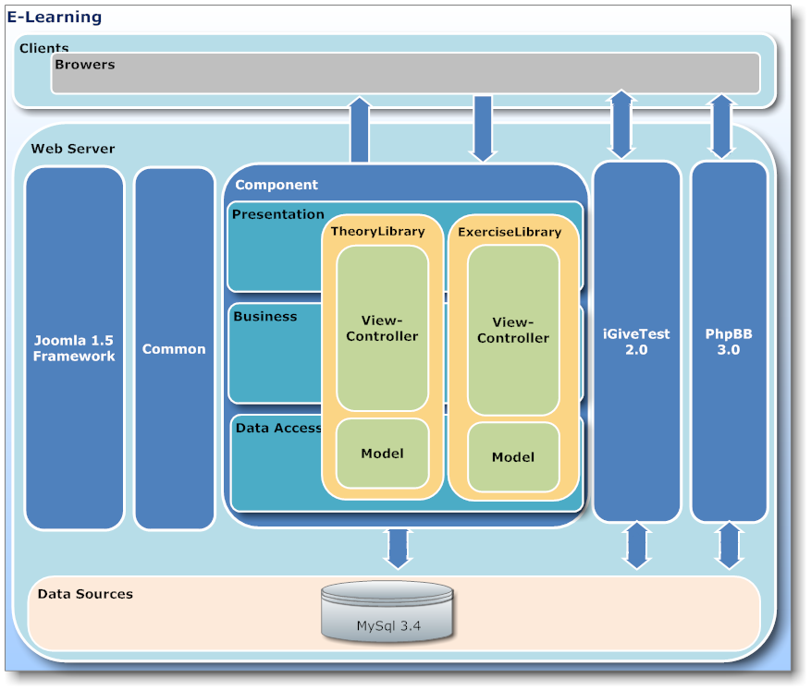
System Analysis and Design Architecture design namnh

Slide 17
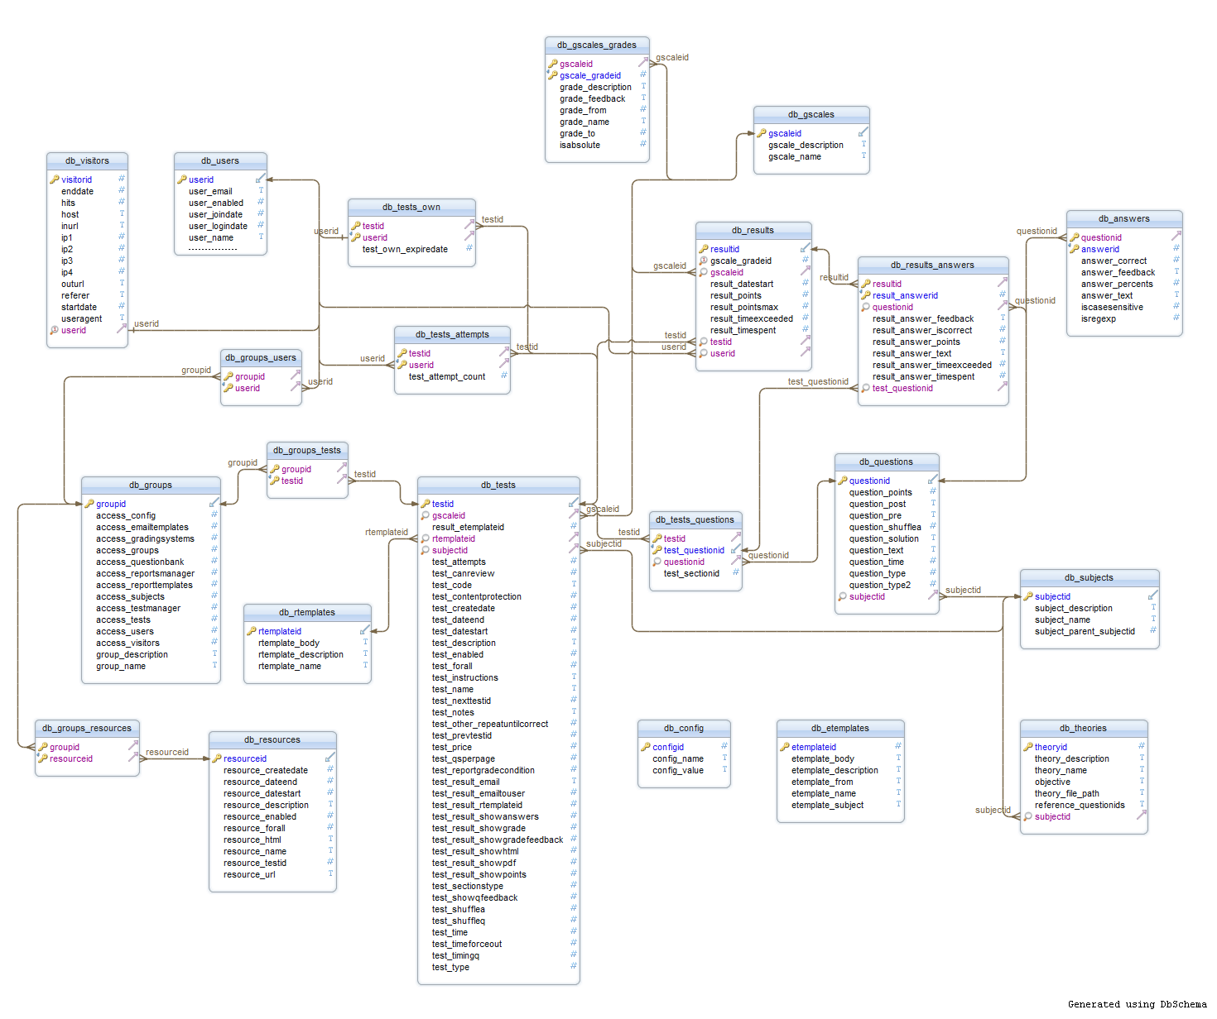
System Analysis and Design Database Structure namnh

Slide 18
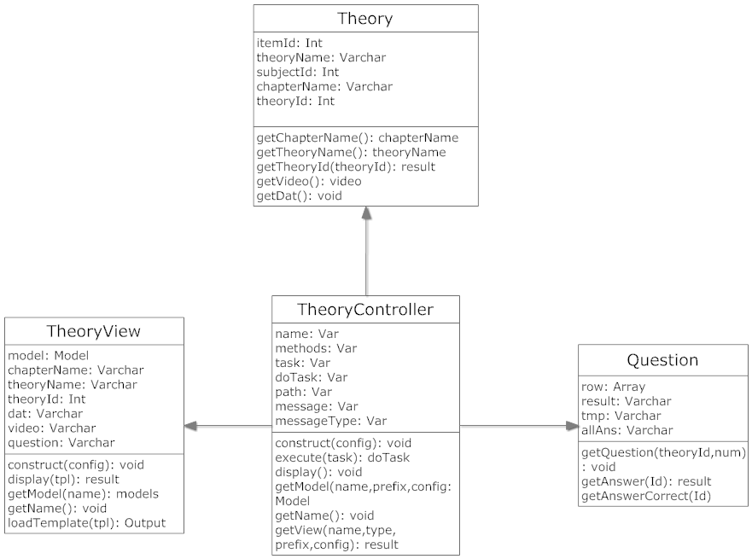
System Analysis and Design Class diagram namnh

Slide 19
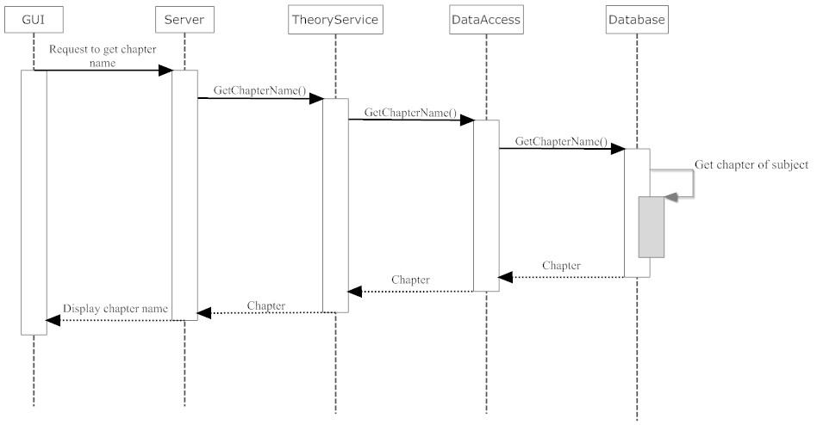
System Analysis and Design Sequence diagram namnh

Slide 20
Test plan
Hung nt

Slide 21
Test report
Hung nt

Slide 22
summary
Hung nt

Slide 23
Q&A

Slide 24
Thank You

